Slide 1


K.RAMAKRISHNAN COLLEGE OF ENGINEERING
(AUTONOMOUS)
Unified-booking-platform
Presented by,
Name : AKASH KANNAH R, MUKESH KANNA R, LEANDER ROSHAN L Register No. : 8115U23IT016, 8115U23IT045, 8115U23IT019
Roll. No. : ITA2316, ITA2345, ITA2319
Year & Section : III & A
Course Code : ITB1332
Course Name : DESIGN PROJECT
Date of Review :24/02/2026

Slide 2
AGENDA
Objective
Introduction
Literature Survey
Workflow
Modules
Dataflow

Slide 3
OBJECTIVE
Develop secure unified platform for booking movies, buses, trains, hotels.
Implement encrypted authentication ensuring strong user login and authorization.
Integrate AI RAG chatbot for intelligent movie-based emotional recommendations
Design responsive user interface using react,tailwind,ensuring seamless experiences
Utilize MongoDB database with Node.js backend for scalable performance.

Slide 4
INTRODUCTION
Unified Booking Platform simplifies ticket reservations across multiple services.
The system integrates movies, buses, trains, and hotels seamlessly.
Secure authentication ensures encrypted user data and protected transactions.
It delivers a modern, efficient, and user-centric digital cinema booking experience
Ai-powered chatbot enhances user experience with intelligent recommendations.
Modern technologies like React, Node.js, and MongoDB ensure scalability.

Slide 5
LITERATURE SURVEY
Paper Title | Author(s) | Year | Pros | Cons
Unified Online Ticket Booking System Using MERN Stack | Rahul Verma et al. | 2023 | Integrates multiple booking services, Improves user convenience, Reduces manual errors | Complex system integration, Requires strong backend management, Higher server dependency
AI-Powered Recommendation System for Entertainment Platforms | Neha Reddy et al. | 2024 | Provides personalized suggestions, Enhances engagement, Improves customer satisfaction | Needs large datasets, Increased computational cost, Model maintenance required
Secure Web-Based Payment and Authentication Framework | Karthik Iyer et al. | 2025 | Strengthens encrypted login, Protects transactions, Supports secure online payments | Implementation complexity, Continuous security updates required, Higher infrastructure cost

Slide 6
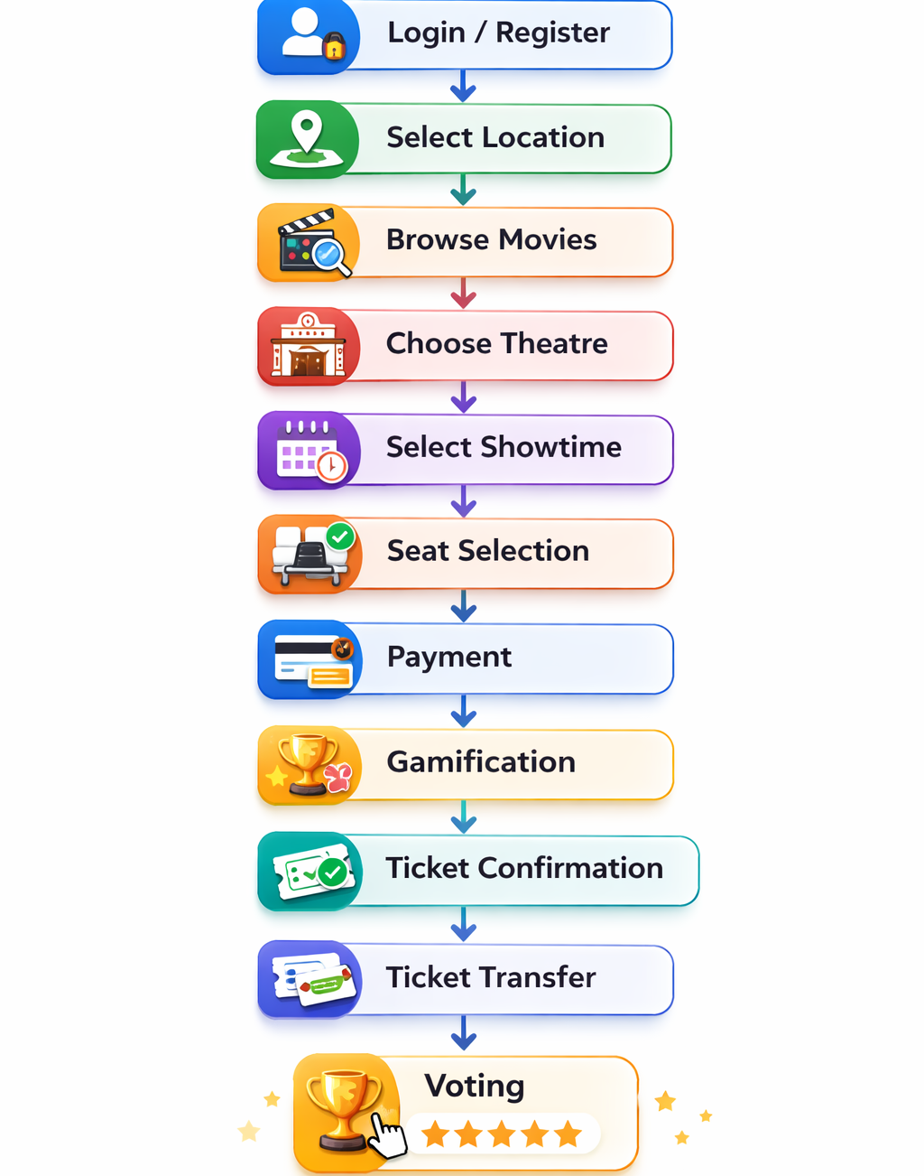
WORKFLOW

Slide 7
MODULES
User Authentication System – Secure encrypted login and validation
User Management Module – Manage profiles and booking history
Admin Dashboard Panel – Control platform services and users
Movie Booking System – Select seats and confirm tickets
Transport Booking Module – Search routes and book tickets
Hotel Reservation System – Check availability and reserve rooms
Payment Processing Module – Process secure online transactions safely
AI Chatbot System – Provide intelligent emotional movie recommendations
Search Filter Module – Advanced filtering and sorting options
Analytics Reporting System – Generate booking and revenue reports

